Slide 1
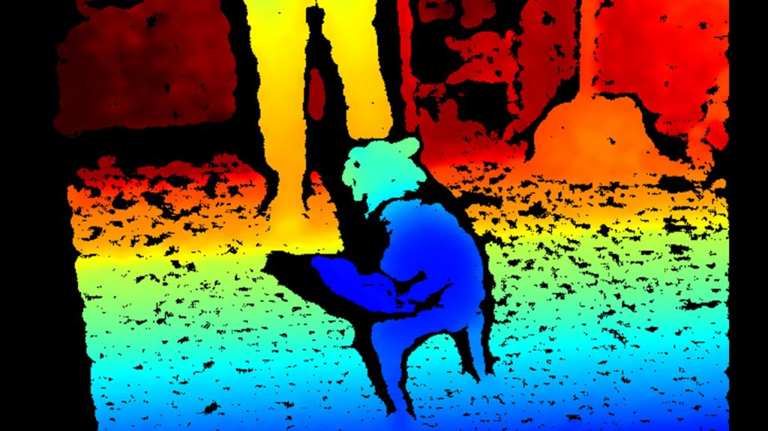
Stereo

Slide 2
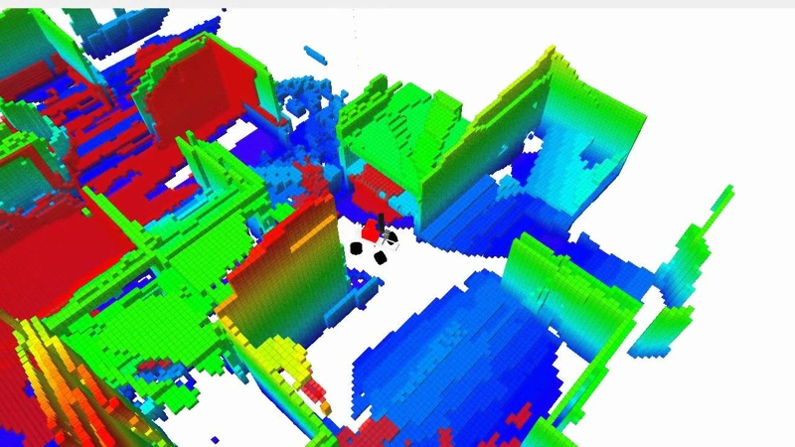
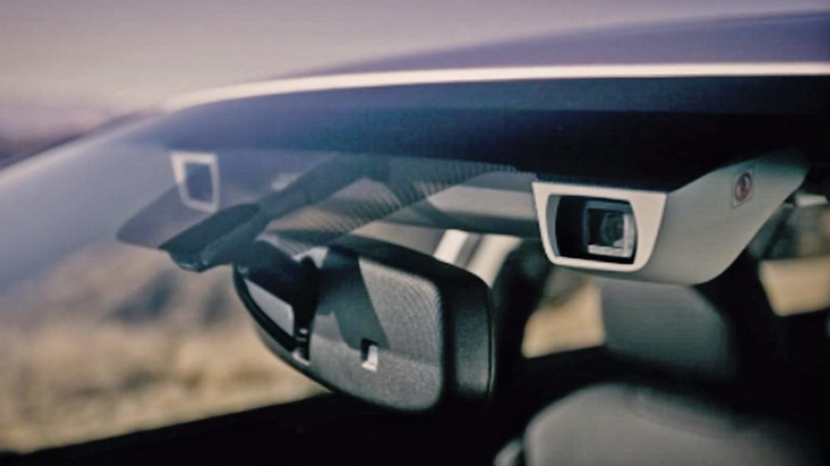
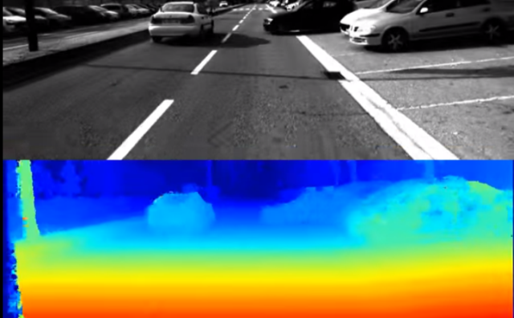
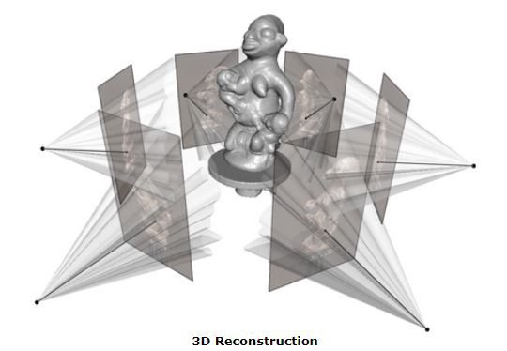
What can be done with stereo vision?
SLAM- robot navigation
Autonomous driving
3D reconstruction

Slide 3
References
http://szeliski.org/Book/
http://www.cs.cornell.edu/courses/cs5670/2019sp/lectures/lectures.html
http://www.cs.cmu.edu/~16385/

Slide 4
Contents
Structure from motion
Triangulation
Stereo matching
Camera rectification
Epipolar geometry
Essential matrix
Fundamental matrix
Estimating the fundamental matrix
Other 3D sensors

Slide 5
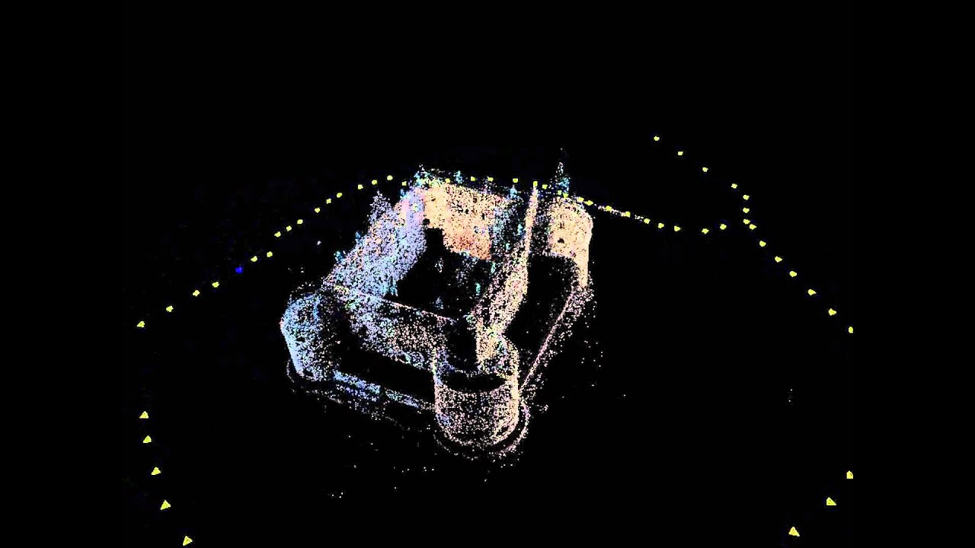
Structure from motion
Structure from motion (SfM) is the process of estimating the 3-D structure of a scene from a set of 2-D images. SfM is used in many applications, such as 3-D scanning and augmented reality.
[Mathworks]
SfM is also known as 3D reconstruction.
Stereo vision is a subcategory of SfM in which we are dealing only with 2 images.

Slide 6
Structure and motion
 | Structure (3D model of world) | Motion (6 DOFs of cameras)
Pose Estimation (camera pose estimation) | Known | Estimate
Triangulation | Estimate | Known
3D reconstruction/ SfM/ stereo vision | Estimate | Estimate

Slide 7
Structure and motion
So essentially one can say that “structure from motion” is the wrong name…
Structure and motion is more precise, but nobody will understand what are you talking about.
In this class we will learn about 3D reconstruction from two cameras (and triangulation as a subtopic).

Slide 8
Contents
Structure from motion
Triangulation
Stereo matching
Camera rectification
Epipolar geometry
Essential matrix
Fundamental matrix
Estimating the fundamental matrix
Other 3D sensors

Slide 9
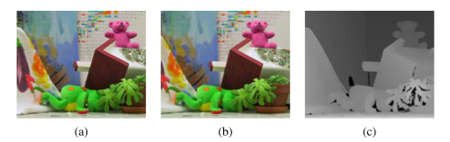
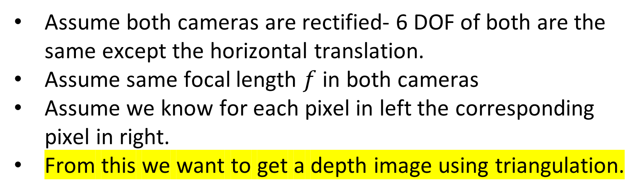
Triangulation
Assume both cameras are rectified- 6 DOF of both are the same except the horizontal translation.
Assume same focal length $f$ in both cameras
Assume we know for each pixel in left the corresponding pixel in right.
From this we want to get a depth image using triangulation.

Slide 10
Left

Slide 11
Right

Slide 12
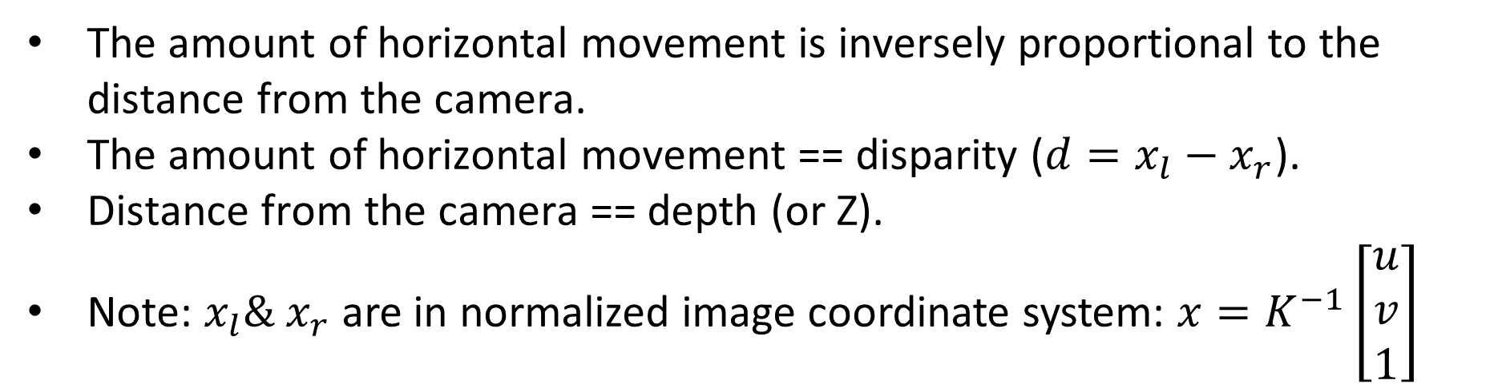
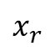
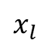
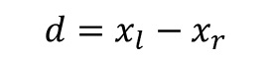
Triangulation
$$x_{l}$$
$$x_{r}$$
$$d=x_{l}−x_{r}$$
The amount of horizontal movement is inversely proportional to the distance from the camera.
The amount of horizontal movement == disparity ($d=x_{l}−x_{r}$).
Distance from the camera == depth (or Z).
Note: $x_{l}\& x_{r}$are in normalized image coordinate system: ${x=K}^{−1}\left[\begin{aligned}u \\ v \\ 1\end{aligned}\right]$

Slide 13
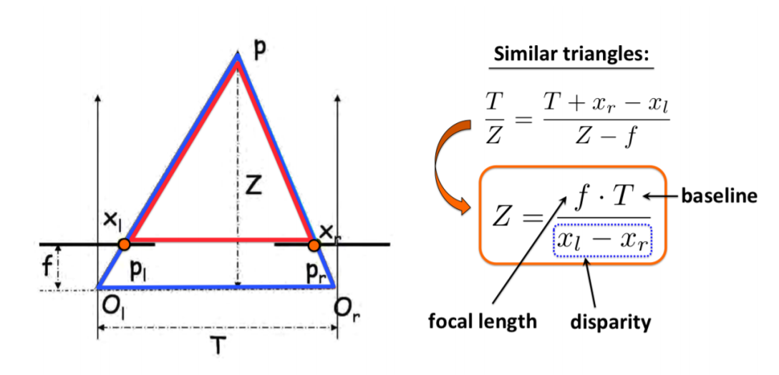

Triangulation
$$T−d$$

Slide 14
Contents
Structure from motion
Triangulation
Stereo matching
Camera rectification
Epipolar geometry
Essential matrix
Fundamental matrix
Estimating the fundamental matrix
Other 3D sensors

Slide 15
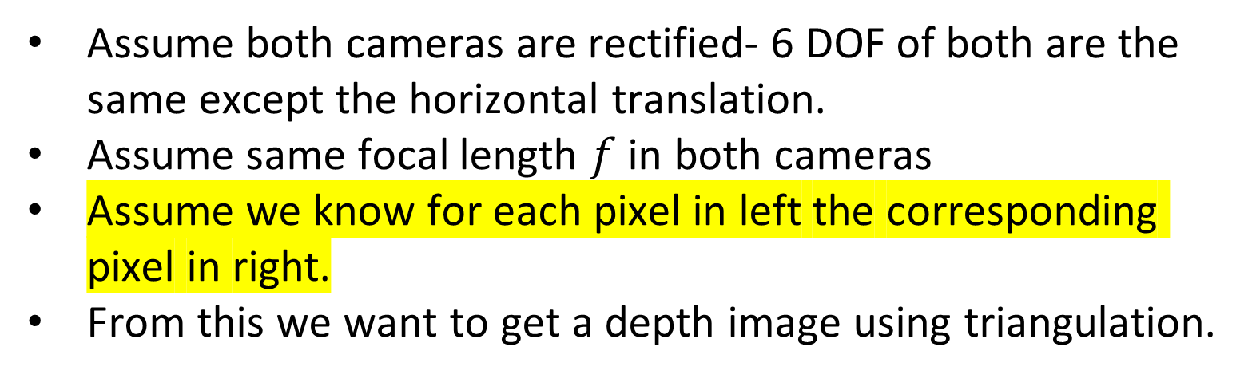
Triangulation
Assume both cameras are rectified- 6 DOF of both are the same except the horizontal translation.
Assume same focal length $f$ in both cameras
Assume we know for each pixel in left the corresponding pixel in right.
From this we want to get a depth image using triangulation.

Slide 16
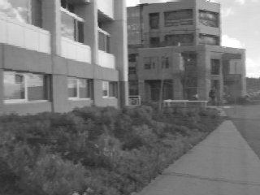
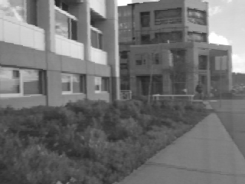
Stereo Block Matching
Left
Right
scanline
Matching cost
disparity
Slide a window along the epipolar line and compare contents of that window with the reference window in the left image
Matching cost: SSD or normalized correlation

Slide 17
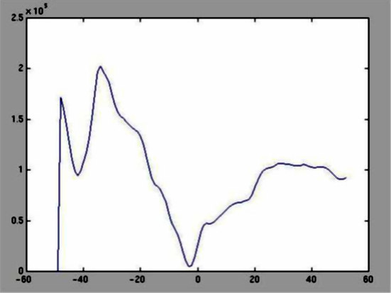
SSD

Slide 18
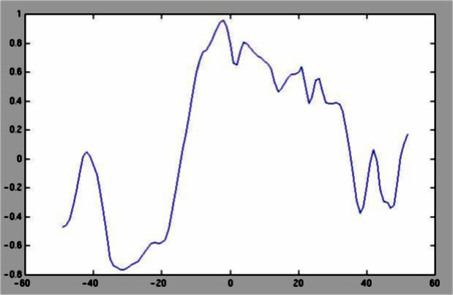
Normalized cross-correlation

Slide 19
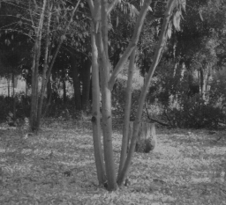
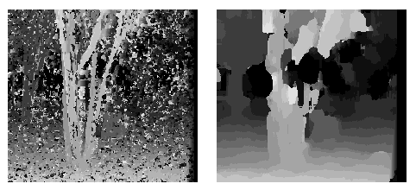
Effect of window size
W = 3
W = 20

Slide 20
Effect of window size
W = 3
W = 20
Smaller window
+ More detail
- More noise
Larger window
+ Smoother disparity maps
- Less detail
- Fails near boundaries

Slide 21
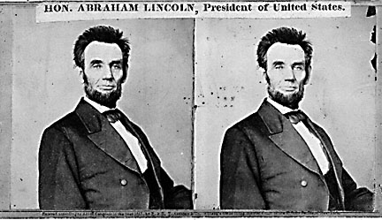
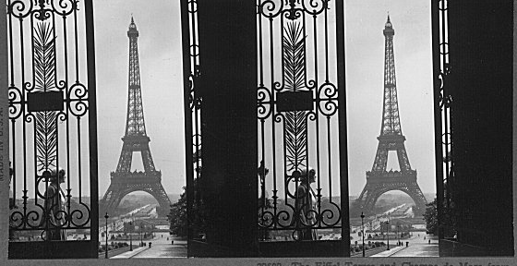


When will stereo block matching fail?

Slide 22
When will stereo block matching fail?
textureless regions
repeated patterns
specularities

Slide 23
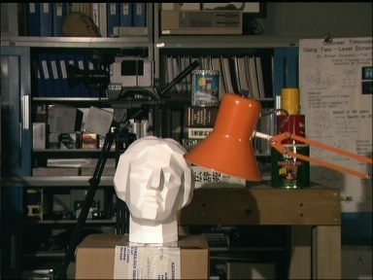
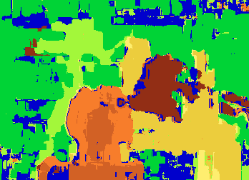

Block matching
Ground truth
What are some problems with the result?

Slide 24
How can we improve depth estimation?

Slide 25
How can we improve depth estimation?
Too many discontinuities.
We expect disparity values to change slowly.
Let’s make an assumption:
depth should change smoothly

Slide 26

Energy Minimization
What defines a good stereo correspondence?
Match quality
Want each pixel to find a good match in the other image
Smoothness
If two pixels are adjacent, they should (usually) move about the same amount

Slide 27
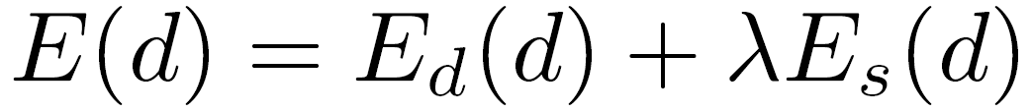
energy function
(for one pixel)
{
{
data term
smoothness term
Want each pixel to find a good match in the other image
Adjacent pixels should (usually) move about the same amount
(block matching result)
(smoothness function)

Slide 28


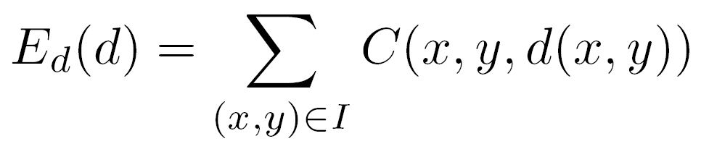
data term
SSD distance between windows centered at I(x, y) and J(x+ d(x,y), y)

Slide 29


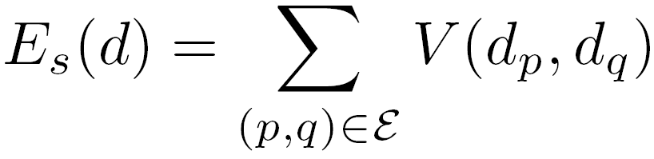

SSD distance between windows centered at I(x, y) and J(x+ d(x,y), y)
smoothness term
: set of neighboring pixels
4-connected neighborhood
8-connected neighborhood

Slide 30

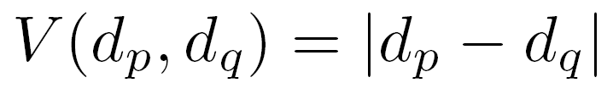
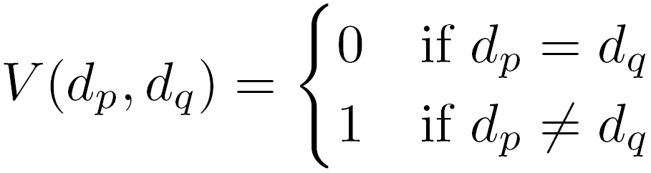
smoothness term
L₁ distance
“Potts model”

Slide 31
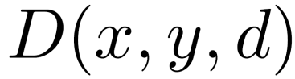
Dynamic Programming
One possible solution…
Can minimize this independently per scanline using dynamic programming (DP)
: minimum cost of solution such that d(x,y) = d

Slide 32
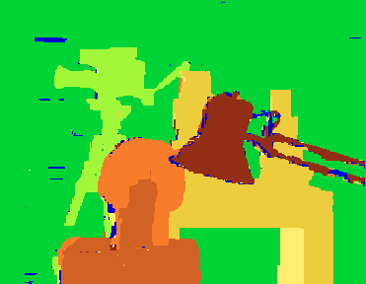
Match only
Match & smoothness (via graph cut)
Ground Truth
Y. Boykov, O. Veksler, and R. Zabih, Fast Approximate Energy Minimization via Graph Cuts, PAMI 2001

Slide 33
Contents
Structure from motion
Triangulation
Stereo matching
Camera rectification
Epipolar geometry
Essential matrix
Fundamental matrix
Estimating the fundamental matrix
Other 3D sensors

Slide 34
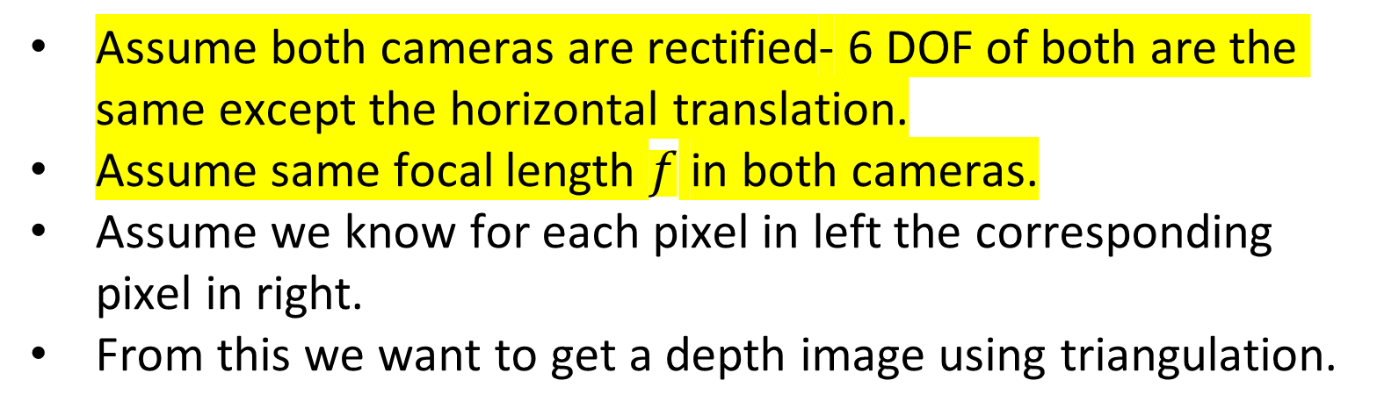
Triangulation
Assume both cameras are rectified- 6 DOF of both are the same except the horizontal translation.
Assume same focal length $f$ in both cameras.
Assume we know for each pixel in left the corresponding pixel in right.
From this we want to get a depth image using triangulation.

Slide 35
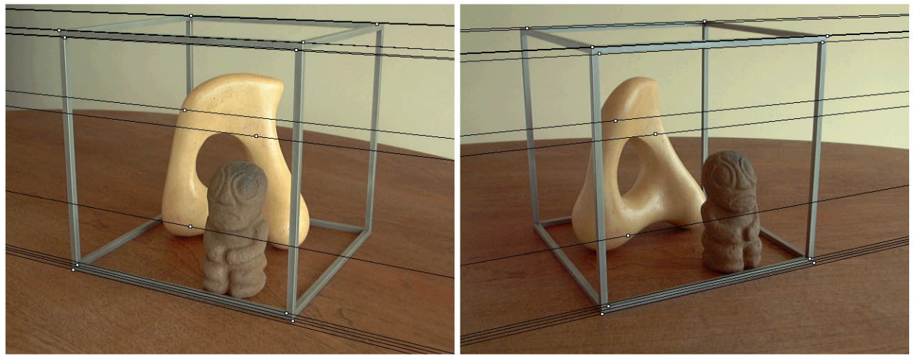
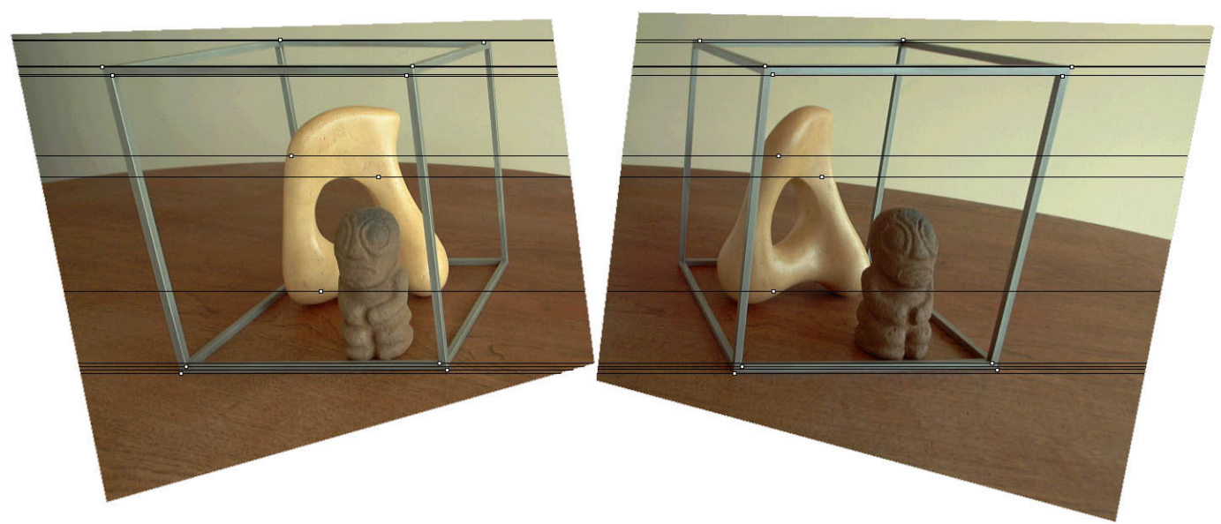
Original stereo pair
After rectification

Slide 36
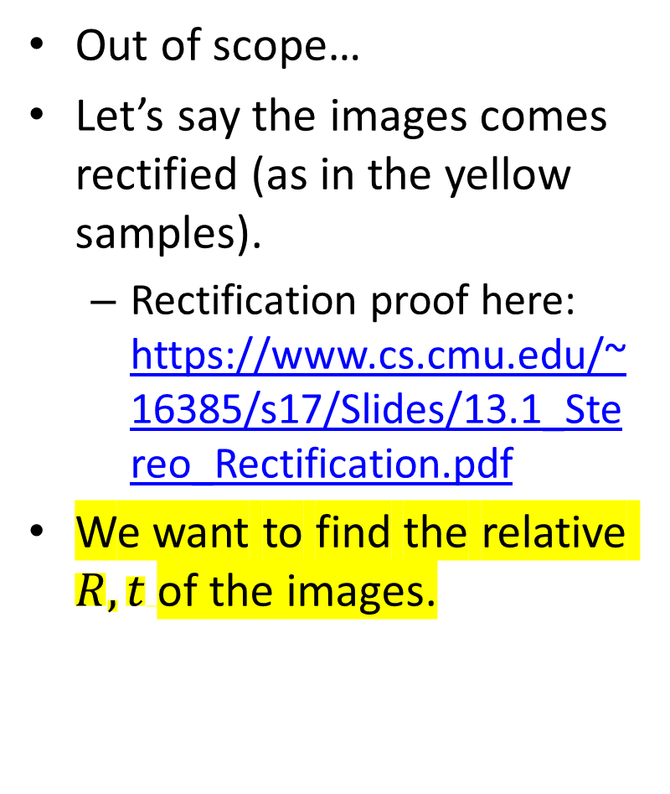
Stereo image rectification
Out of scope…
Let’s say the images comes rectified (as in the yellow samples).
Rectification proof here: https://www.cs.cmu.edu/~16385/s17/Slides/13.1_Stereo_Rectification.pdf
We want to find the relative $R,t$of the images.

Slide 37
Contents
Structure from motion
Triangulation
Stereo matching
Camera rectification
Epipolar geometry
Essential matrix
Fundamental matrix
Estimating the fundamental matrix
Other 3D sensors

Slide 38
Epipolar geometry
Epipolar geometry is the geometry of stereo vision. When two cameras view a 3D scene from two distinct positions, there are a number of geometric relations between the 3D points and their projections onto the 2D images that lead to constraints between the image points.
[Wikipedia]

Slide 39
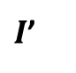
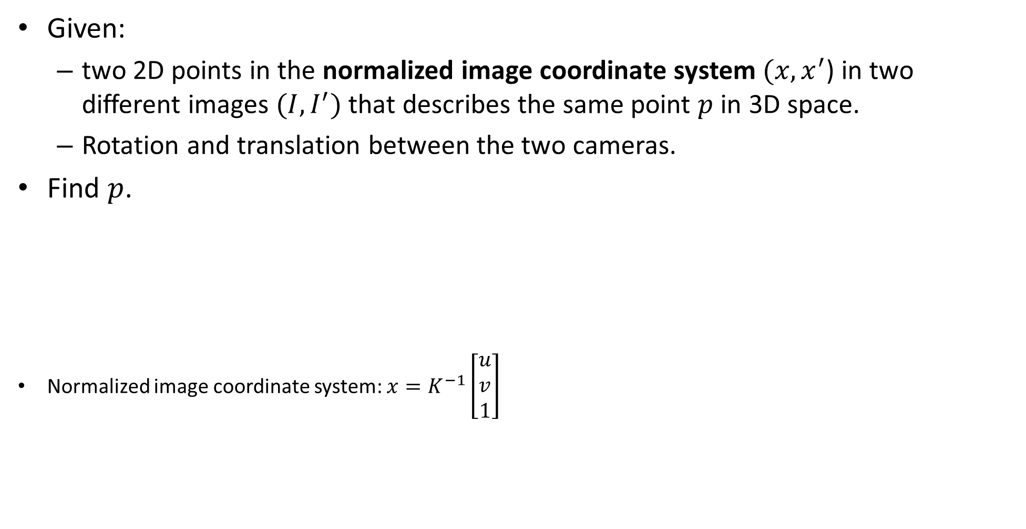

Epipolar geometry - The triangulation problem
Given:
two 2D points in the normalized image coordinate system $(x,x^{′}$) in two different images $(I,I^{′})$ that describes the same point $p$ in 3D space.
Rotation and translation between the two cameras.
Find $p$.
Normalized image coordinate system: ${x=K}^{−1}\left[\begin{aligned}u \\ v \\ 1\end{aligned}\right]$
$$I$$
$I$’

Slide 40


Epipolar geometry
$$I$$
$I$’

Slide 41
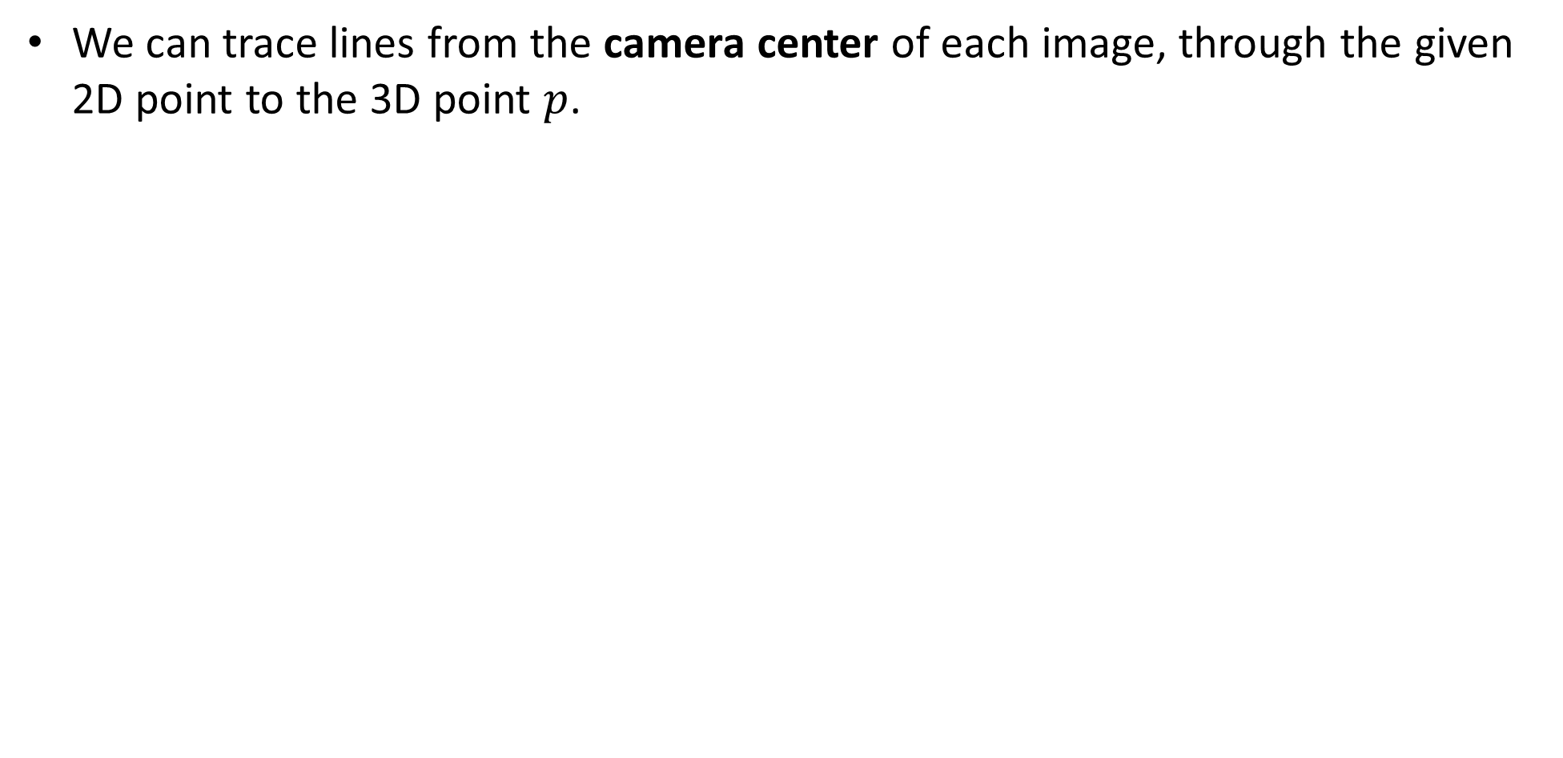
Epipolar geometry
We can trace lines from the camera center of each image, through the given 2D point to the 3D point $p$.
Camera center
$$I$$
$I$’

Slide 42
Epipolar geometry
Baseline is a vector that represent the translation between two cameras
Baseline
$$I$$
$I$’

Slide 43
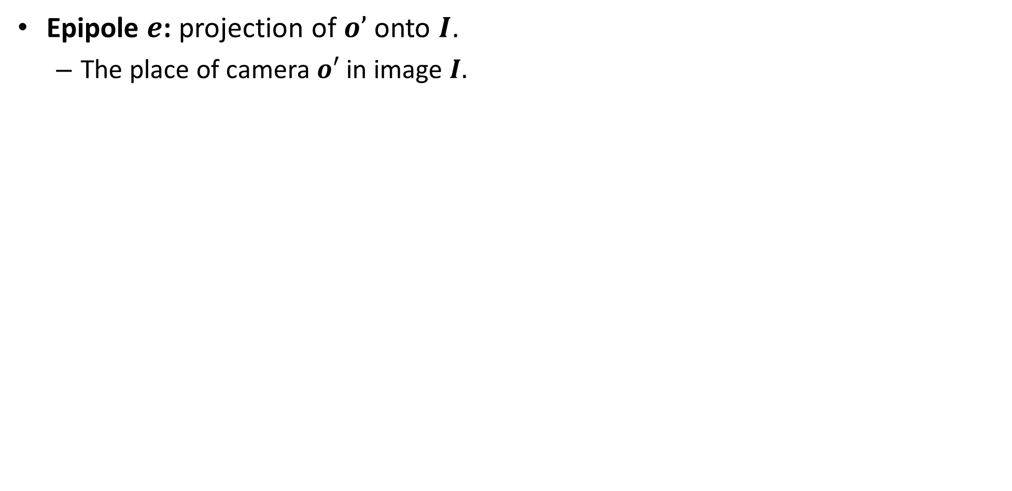

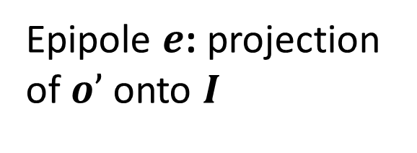
Epipolar geometry
Epipole $e$: projection of $o’$onto $I$.
The place of camera $o′$ in image $I.$
Epipole $e$: projection of $o’$onto $I$
$$I$$
$I$’

Slide 44
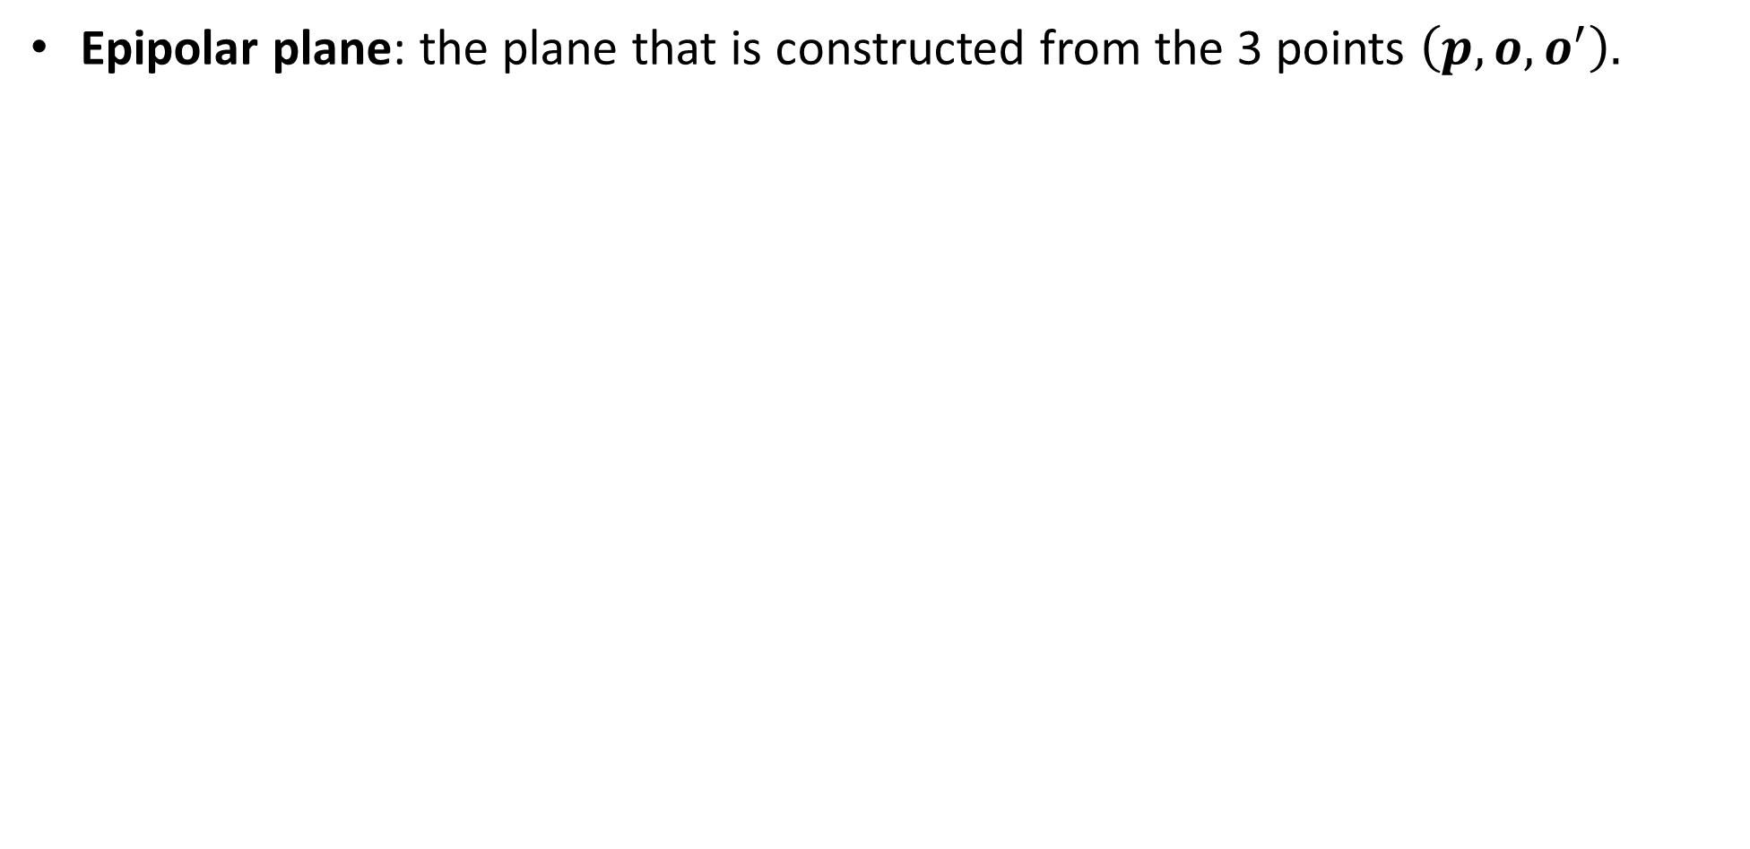
Epipolar geometry
Epipolar plane: the plane that is constructed from the 3 points $\left(p,o,o^{′}\right).$
Epipolar plane
$$I$$
$I$’

Slide 45

Epipolar geometry
Epipolar line: intersection of Epipolar plane and image plane.
Epipolar line
$$I$$
$I$’

Slide 46
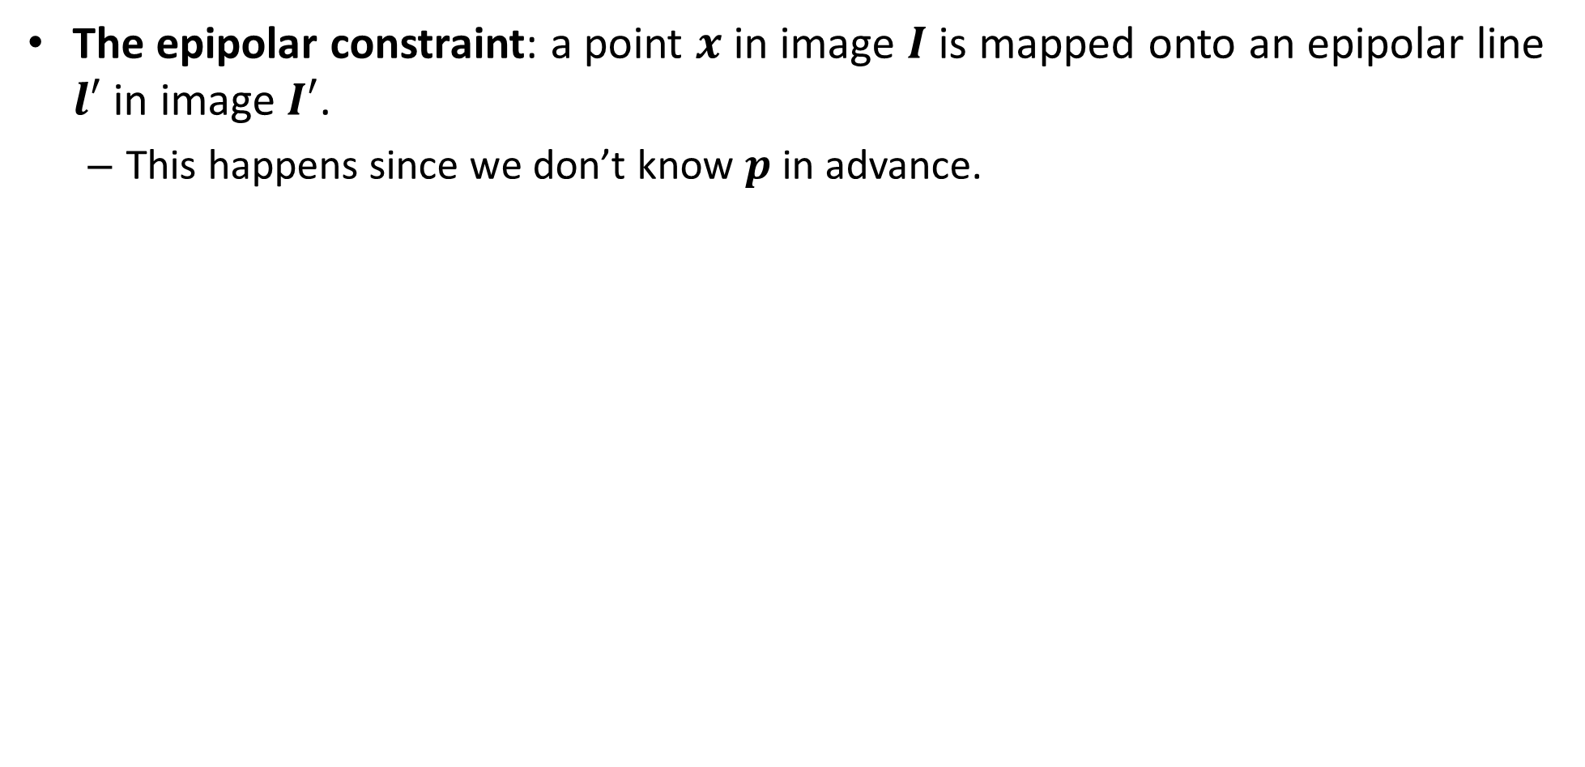
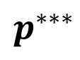
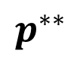
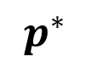
Epipolar constraint
The epipolar constraint: a point $x$ in image $I$ is mapped onto an epipolar line $l′$ in image $I′$.
This happens since we don’t know $p$ in advance.
$$p^{∗}$$
$$p^{∗∗}$$
$$p^{∗∗∗}$$
$$I$$
$I$’

Slide 47
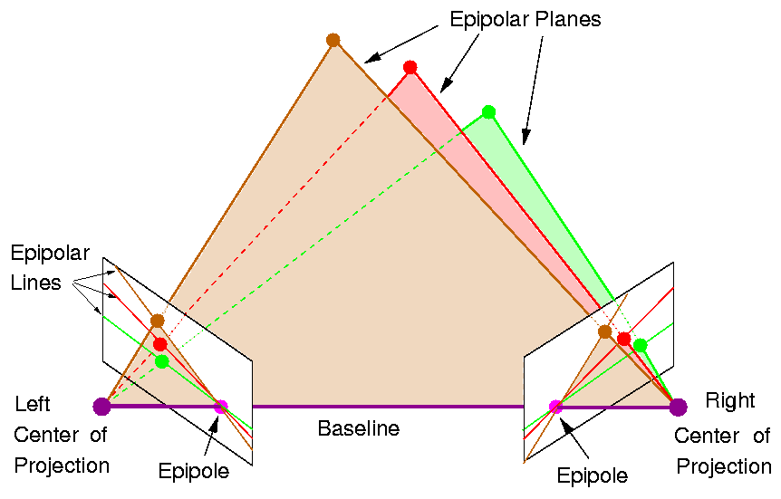
Epipolar geometry
Note: all epipolar lines pass through the epipole.

Slide 48
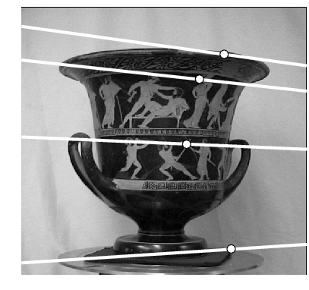
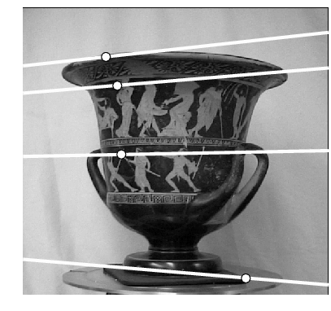
Epipolar geometry
Where is the epipole in this images?

Slide 49
Epipolar geometry
Where is the epipole in this images? The epipole doesn’t have to be inside the image!
here!

Slide 50
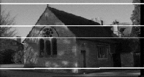
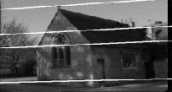
Epipolar geometry
Where is the epipole in this image?

Slide 51
Epipolar geometry
Where is the epipole in this image? The epipolar lines doesn’t converge since the baseline (translation) is parallel to the image plane!

Slide 52

Epipolar geometry
Even if the image plane $I$ was infinite, you can’t see the place of $o′$.

Slide 53
Contents
Structure from motion
Triangulation
Stereo matching
Camera rectification
Epipolar geometry
Essential matrix
Fundamental matrix
Estimating the fundamental matrix
Other 3D sensors

Slide 54

Recall: Dot Product
Dot product of two orthogonal vectors is zero.
Dot product can also be written as vector multiplication [$a,b$are size $3X1$]:
$$a∙b=0 ↔a^{T}b=0$$

Slide 55
Recall: Cross Product
Vector (cross) product takes two vectors and returns a vector perpendicular to both

Slide 56


Recall: Cross Product
Can also be written as a matrix multiplication
Skew symmetric

Slide 57





Building the essential matrix
Let’s define the $o$ system as world coordinate system.
*$t$ here is $c$ from camera calibration class

Slide 58




Building the essential matrix
These three vectors are coplanar

Slide 59

Building the essential matrix
These three vectors are coplanar

Slide 60

Building the essential matrix
These three vectors are coplanar

Slide 61

Building the essential matrix
These three vectors are coplanar

Slide 62

Building the essential matrix
These three vectors are coplanar

Slide 63



Building the essential matrix
rigid motion
coplanarity
$$R^{T}=R^{−1}$$
$$R^{T}x^{′}=x−t \\ {x^{′}}^{T}R={\left(x−t\right)}^{T}$$

Slide 64

Building the essential matrix
rigid motion
coplanarity
$$R^{T}=R^{−1}$$
$$R^{T}x^{′}=x−t \\ {x^{′}}^{T}R={\left(x−t\right)}^{T}$$
$${{(x}^{′}}^{T}R)\left({\left[t\right]}_{x}x\right)=0$$

Slide 65

Building the essential matrix
rigid motion
coplanarity
$$R^{T}=R^{−1}$$
$$R^{T}x^{′}=x−t \\ {x^{′}}^{T}R={\left(x−t\right)}^{T}$$
$${{(x}^{′}}^{T}R)\left({\left[t\right]}_{x}x\right)=0 \\ {x^{′}}^{T}\left({R\left[t\right]}_{x}\right)x=0$$

Slide 66

Building the essential matrix
rigid motion
coplanarity
$$R^{T}=R^{−1}$$
$$R^{T}x^{′}=x−t \\ {x^{′}}^{T}R={\left(x−t\right)}^{T}$$
$${{(x}^{′}}^{T}R)\left({\left[t\right]}_{x}x\right)=0 \\ {x^{′}}^{T}\left({R\left[t\right]}_{x}\right)x=0$$

Slide 67


Building the essential matrix
rigid motion
coplanarity
$$R^{T}=R^{−1}$$
$$R^{T}x^{′}=x−t \\ {x^{′}}^{T}R={\left(x−t\right)}^{T}$$
$${{(x}^{′}}^{T}R)\left({\left[t\right]}_{x}x\right)=0 \\ {x^{′}}^{T}\left({R\left[t\right]}_{x}\right)x=0$$
Essential Matrix
$$E={R\left[t\right]}_{x}$$

Slide 68

Side note: another representation
Sometimes you can find $E$ marked as $E=$ ${\left[t\right]}_{x}R$.
$$x^{T}\left({\left[t\right]}_{x}R\right)x^{′}=0 \\ {(x}^{T}\left({\left[t\right]}_{x}R\right)x^{′})^{T}=0 \\ x^{′T}\left({R^{T}\left[t\right]}_{x}^{T}\right)x^{T}=0 \\ x^{′T}\left(R^{−1}(−{\left[t\right]}_{x})\right)x^{T}=0 \\ x^{′T}\left(R^{−1}{\left[−t\right]}_{x}\right)x^{T}=0$$
Find reference

Slide 69

properties of the E matrix
(points in normalized image coordinates)
Essential matrix definition
$$x^{′T}Ex=0$$

Slide 70

Epipolar lines equation
Recall this version of line equation:
$$ax+by+c=0$$
For homogenous vector$x=\left[\begin{aligned}x \\ y \\ 1\end{aligned}\right]$ and $l=\left[\begin{aligned}a \\ b \\ c\end{aligned}\right]$:
$x^{T}l=l^{T}x=0$

Slide 71

Epipolar lines equation
$x^{′T}Ex=x^{′T}l^{′}=0$ $Ex=l^{′}$ is the epipolar line in $I^{′}$ corresponding to $x$.
$x^{′T}Ex=l^{T}x=0$ ${{(x}^{′T}E)}^{T}={l^{T}}^{T}=l$is the epipolar line in $I$corresponding to $x′$.

Slide 72

properties of the E matrix
Full proof for the epipolar lines can be found here:
http://www.cs.cornell.edu/courses/cs4670/2015sp/lectures/lec21_stereo_web.pdf
(points in normalized image coordinates)
Essential matrix definition
$$x^{′T}Ex=0$$
$Ex=l^{′}$ is the epipolar line in $I^{′}$ corresponding to $x$
${{(x}^{′T}E)}^{T}={l^{T}}^{T}=l$is the epipolar line in $I$corresponding to $x′$.
Epipolar lines

Slide 73

Epipolar lines equation
$e^{′T}l^{′}=0$ $∀x$s.t. $Ex=l′$, meaning:
$e^{′T}E=0$
$l^{T}e=0 ∀x′$s.t. $x^{′T}E=l^{T}$meaning:
$Ee=0$

Slide 74


properties of the E matrix
(points in normalized image coordinates)
Essential matrix definition
$$x^{′T}Ex=0$$
$Ex=l^{′}$ is the epipolar line in $I^{′}$ corresponding to $x$
${{(x}^{′T}E)}^{T}={l^{T}}^{T}=l$is the epipolar line in $I$corresponding to $x′$.
Epipolar lines
Epipoles
$$e^{′T}E=0$$
$$Ee=0$$

Slide 75
Contents
Structure from motion
Triangulation
Stereo matching
Camera rectification
Epipolar geometry
Essential matrix
Fundamental matrix
Estimating the fundamental matrix
Other 3D sensors

Slide 76



Fundamental matrix
The Essential matrix operates on image points expressed in
normalized coordinates (points have been aligned (normalized) to camera coordinates)
camera point
image point

Slide 77




Fundamental matrix
The Essential matrix operates on image points expressed in
normalized coordinates (points have been aligned (normalized) to camera coordinates)
camera point
image point
Writing out the epipolar constraint in terms of image coordinates
Fundamental Matrix
$$F=K^{′−T}EK^{−1}$$

Slide 78





properties of the F matrix
All of the below functions works with $F$ and un-normalized points the same!
(points in un-normalized image coordinates)
Fundamental matrix definition
$$x^{′T}Fx=0$$
$Fx=l^{′}$ is the epipolar line in $I^{′}$ corresponding to $x$
${{(x}^{′T}F)}^{T}={l^{T}}^{T}=l$is the epipolar line in $I$corresponding to $x′$.
Epipolar lines
Epipoles
$$e^{′T}F=0$$
$$Fe=0$$

Slide 79
Contents
Structure from motion
Triangulation
Stereo matching
Camera rectification
Epipolar geometry
Essential matrix
Fundamental matrix
Estimating the fundamental matrix
Other 3D sensors

Slide 80



Estimating F
Given enough correspondence point between the two images, one can reconstruct the fundamental matrix $F.$
If $K_{1},K_{2}$are known, we can find $E.$
We can then decompose $E$ to $R,t$ between the two images (This part is out of scope for this lecture).
$t$ is found up to a scale in the estimation but it’s easy to get a good measure of it with a ruler.

Slide 81
Estimating F – 8-point algorithm
The fundamental matrix F is defined by
for any pair of matches x and x’ in two images.
Let x=(u,v,1)^{T} and x’=(u’,v’,1)^{T},
each match gives a linear equation

Slide 82
8-point algorithm
Like with homographies, instead of solving , we seek f to minimize , least eigenvector of .

Slide 83
8-point algorithm – Problem?
F should have rank 2
To enforce that F is of rank 2, F is replaced by F’ that minimizes subject to the rank constraint.
This is achieved by SVD. Let , where
, let
then is the solution.

Slide 84
8-point algorithm
Pros: it is linear, easy to implement and fast
Cons: susceptible to noise.
Solutions: (all out of scope)
normalized 8 points algorithm.
7 points algorithm.
Finding K,K’ with single camera intrinsics calibration and then search for E (only 5 DOFs instead of 8/7).

Slide 85
Contents
Structure from motion
Triangulation
Stereo matching
Camera rectification
Epipolar geometry
Essential matrix
Fundamental matrix
Estimating the fundamental matrix
Other 3D sensors

Slide 86


Other types of 3D sensors
LIDAR, which stands for Light Detection and Ranging (or light radar), is a remote sensing method that uses light in the form of a pulsed laser to measure ranges.
Most known: velodyne projector.

Slide 87


Other types of 3D sensors
Structured light

Slide 88

Other types of 3D sensors
Coded light
Realsense SR305
https://www.youtube.com/watch?v=PluL7WTlKrM

Slide 89




Other types of 3D sensors
Light Coding
Used in Kinect v1- Kinect for xbox 360.
Iphone x front camera

